Slide 1
East Carolina University Central Motor Pool
Enterprise Rent-A-Car Instructions

Slide 2
Ways to Reserve a Vehicle
Website: https://partner.rentalcar.com/stateofnorthcarolina/#/business/universities
Phone (Local):
104 Greenville Blvd SE – 252-321-2805
Pitt Greenville Airport – 400 Airport Rd, Ste E – 252-758-3400
Hastings Ford – 3013 E 10th Street – 252-931-0079
3525 S Memorial Drive – 252-355-0602
Out of State Locations:
To Receive ECU Discount: Please contact Enterprise at 724-525-2325 for Acct # if using ProCard.

Slide 3
Steps to Reserve a Vehicle Online
Enterprise Reservation Site https://partner.rentalcar.com/stateofnorthcarolina/#/business/universities/
Select the ECU account that meets your transportation need
ECU Motor Pool Direct Billing
Driver Paying with ProCard? – ECU Motor Pool ProCard.
Are you booking for your Athletic team? – ECU Athletics.
Do you need a 15 Passenger van? – These reservations should be made over the phone, calling the pick-up location directly. Please follow the complete instructions, including the required Certificate of Insurance Form, on the Office of Environmental Health & Safety web site BEFORE leaving for your destination.
Terms & Conditions
The following amenities and services are included in the base rates provided for business use:
Qualified licensed drivers 18 years and older are eligible and protected while on state business. $1,000,000 Combined Single Limit Third Party Liability Protection in the US for all classes. Zero deductible Damage Waiver in the US for all car classes. Unlimited miles in the US for all car classes.

Slide 4
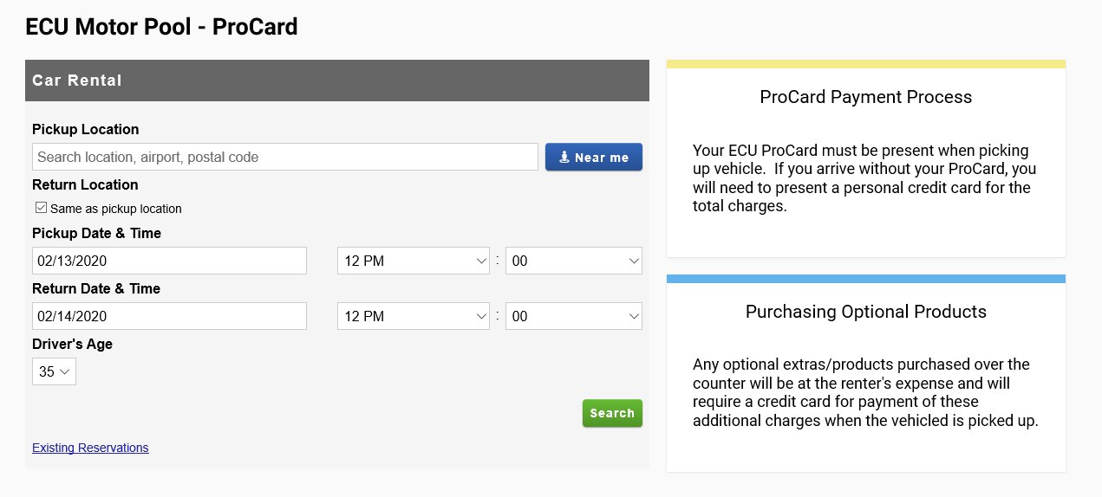
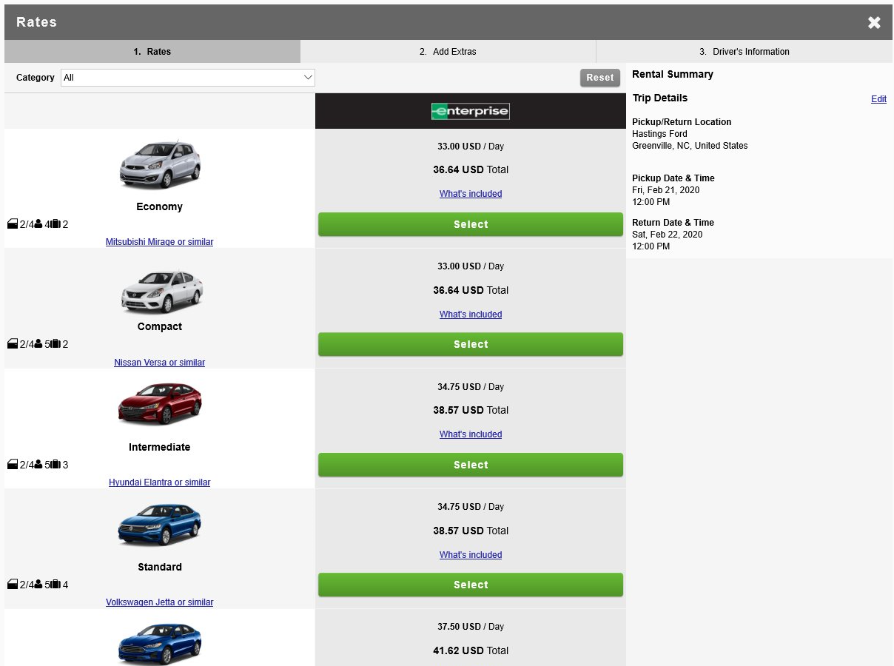
Pickup Location
Pickup/return location, pickup date & time/return date & time, and driver’s age must be completed.
Please Remember – you must have your ecu procard or major credit card with you when you pick up the vehicle.
If the driver would like to use the complimentary service that Enterprise provides with picking up the driver from the office/home, the driver must contact the Enterprise location selected after completing the online reservation.
Select a Vehicle
Select a vehicle from the listed options.

Slide 5
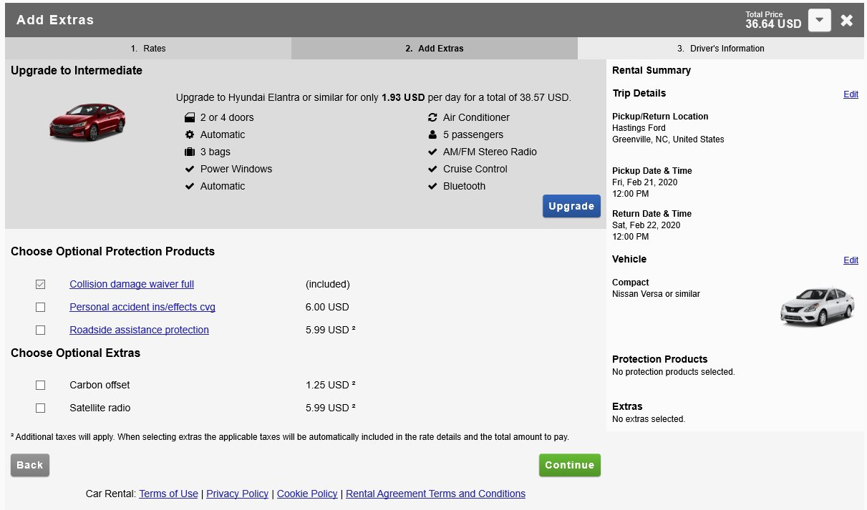
Adding Extras
Collision damage waiver full – this is included with every rental, so this box will always be checked.
Optional Extras – If you do decide to select an “Extra”, you will be responsible for paying for that extra with a personal major credit card when picking up the vehicle.
Please Note – ECU will not pay for any extras selected for your travel.

Slide 6
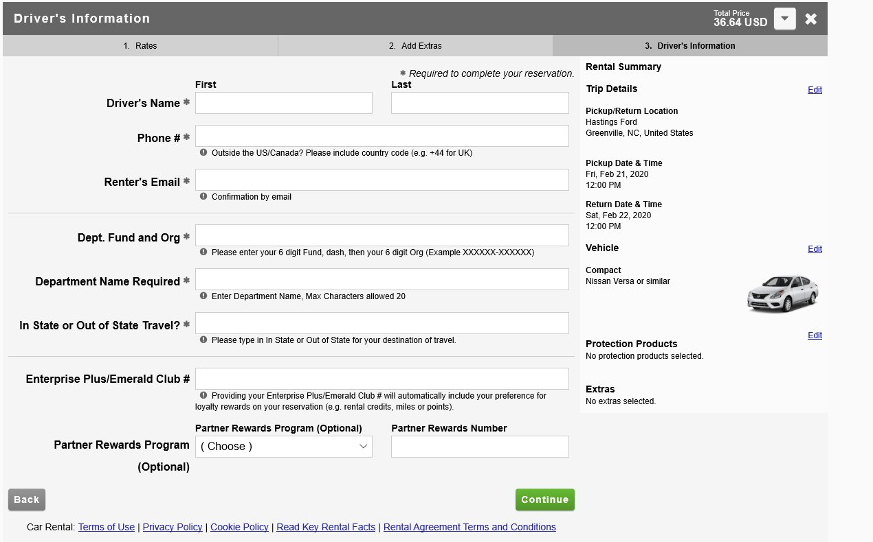
Driver’s Information
Complete the required driver information.
The name on the ECU ProCard/Major Credit Card must match the driver’s name on the reservation.
Dept. Fund and Org
The Department’s FOAP number, Department Name and In State/Out of State information is required.

Slide 7
Enterprise Plus/Emerald Club Member
If you are an Enterprise Plus/Emerald Club member, you will have the opportunity to enter your number.

Slide 8
ECU Billing Number
On the last page of the online reservation system, it will ask for the ECU Billing Number.
This is not the fund/org number; instead, it is a number that Enterprise has assigned to ECU to ensure that the reservation is valid. Your department Admin was provided this number.
If your department does not have this number, please email cmp@ecu.edu.

Slide 9
Personal Vehicle Usage vs. Renting
Please be aware of the new Budget Manual Policy on Mileage Reimbursement.
As stated, Reimbursement for use of personal vehicles should be on a limited basis. If your trip will exceed 100 miles, you will only receive .33 per mile for excess mileage. Therefore, we encourage faculty and staff to utilize Enterprise primarily.
If you do decide to utilize your personal vehicle for University Travel, please reference the DOI Risk Management policy for driving your personal vehicle below:
The State's automobile insurance will not reimburse individuals for deductibles under their private insurance.
Individuals who use their personal vehicle for State business on a routine basis should report the same to their insurance company for rating purposes.
If you have a State Vehicle assigned to your Department, please consider the cost benefits of renting rather than maintaining the vehicle in your department.

Slide 10
Universities that Outsourced Motor Pool to ECHI
Benefits to Using Enterprise
Reduced Costs
Newer Vehicles with improved safety features
Ability to rent Business Use cars across the country

